Slide 1
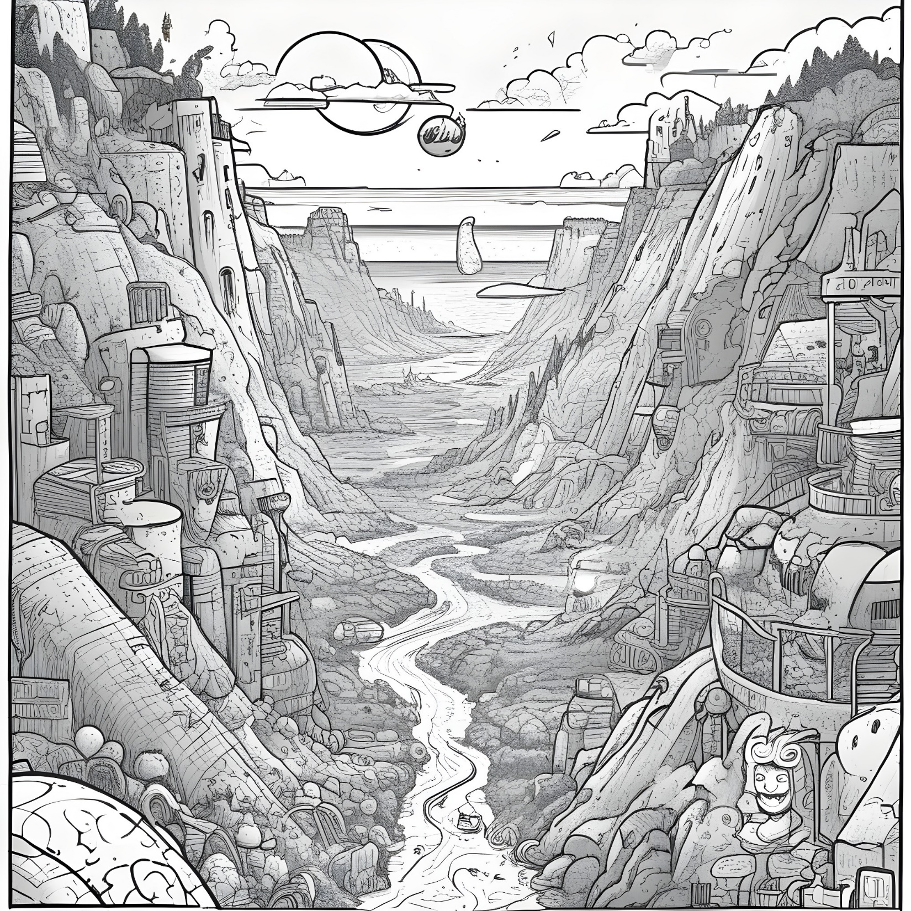
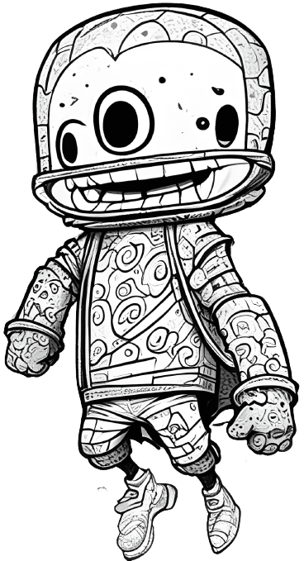
Space Jump:
A Doodle Jump inspired Game
By Sujal Shrestha

Slide 2
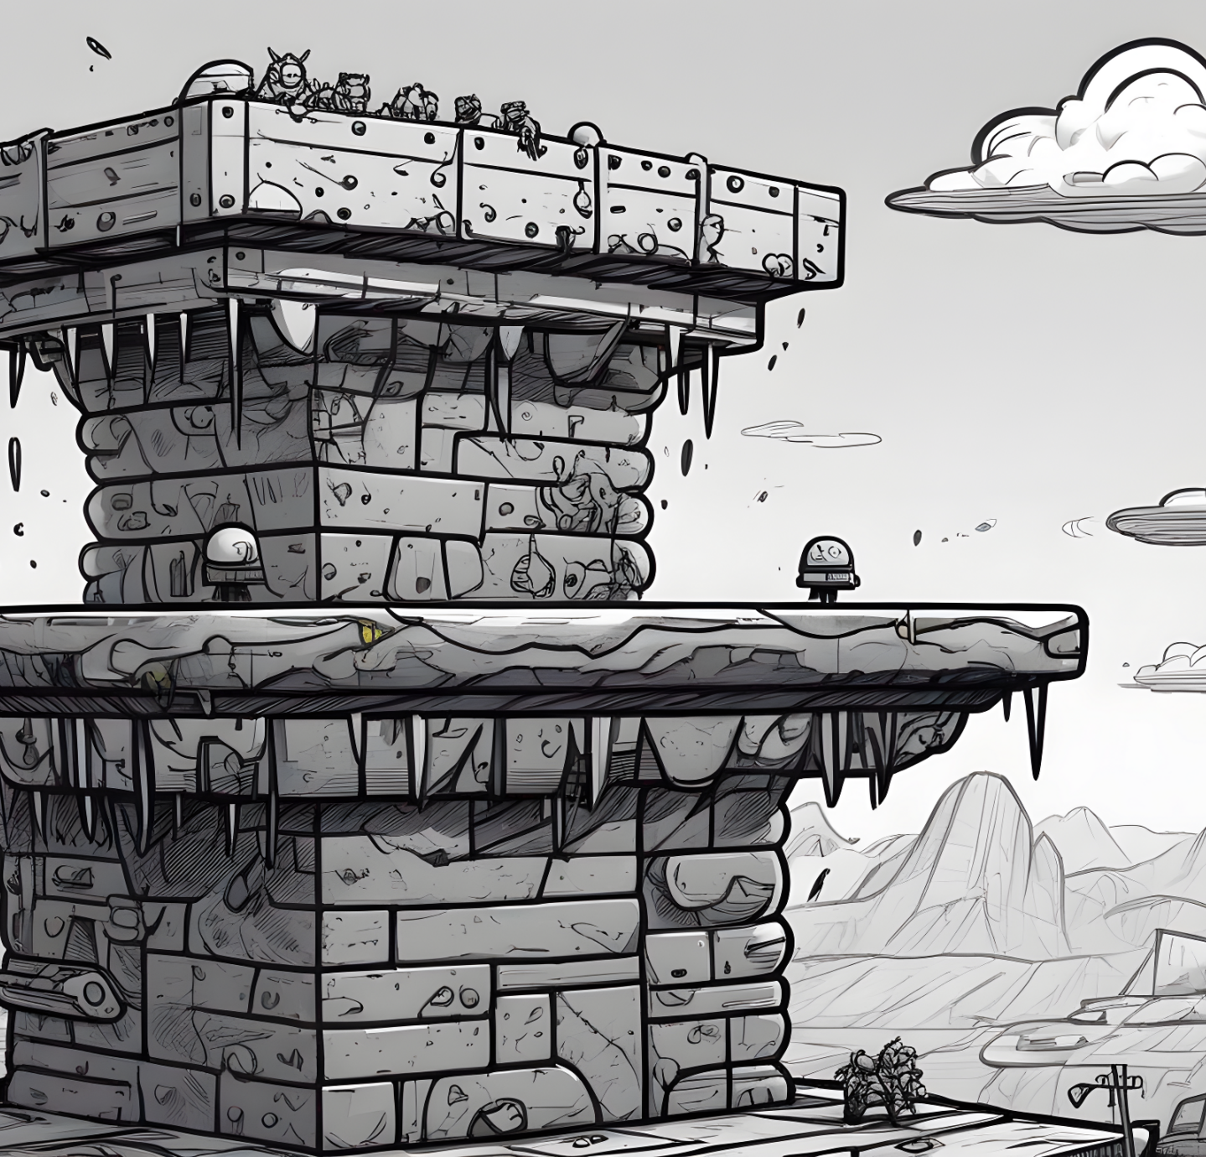
Table of Contents
Biref overview of Doodle Jump
Our game: Space jump
Controls
Rules and Scores

Slide 3
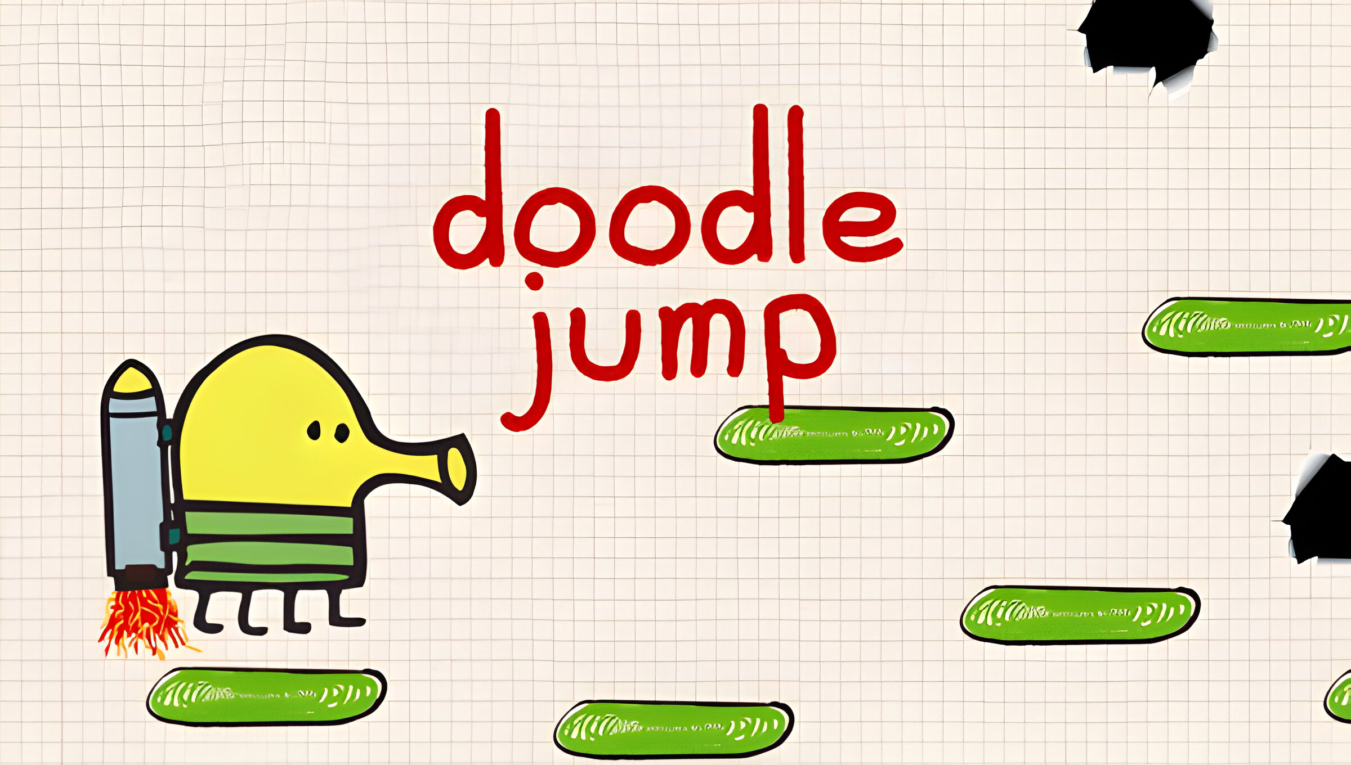
Brief Overview of Doodle Jump:
Doodle Jump is a whimsical mobile game with a bouncing character named Doodler.
Players guide Doodler through a vertical maze of platforms, facing various challenges along the way.
The objective is to achieve the highest score possible in this entertaining and engaging mobile gaming experience.

Slide 4
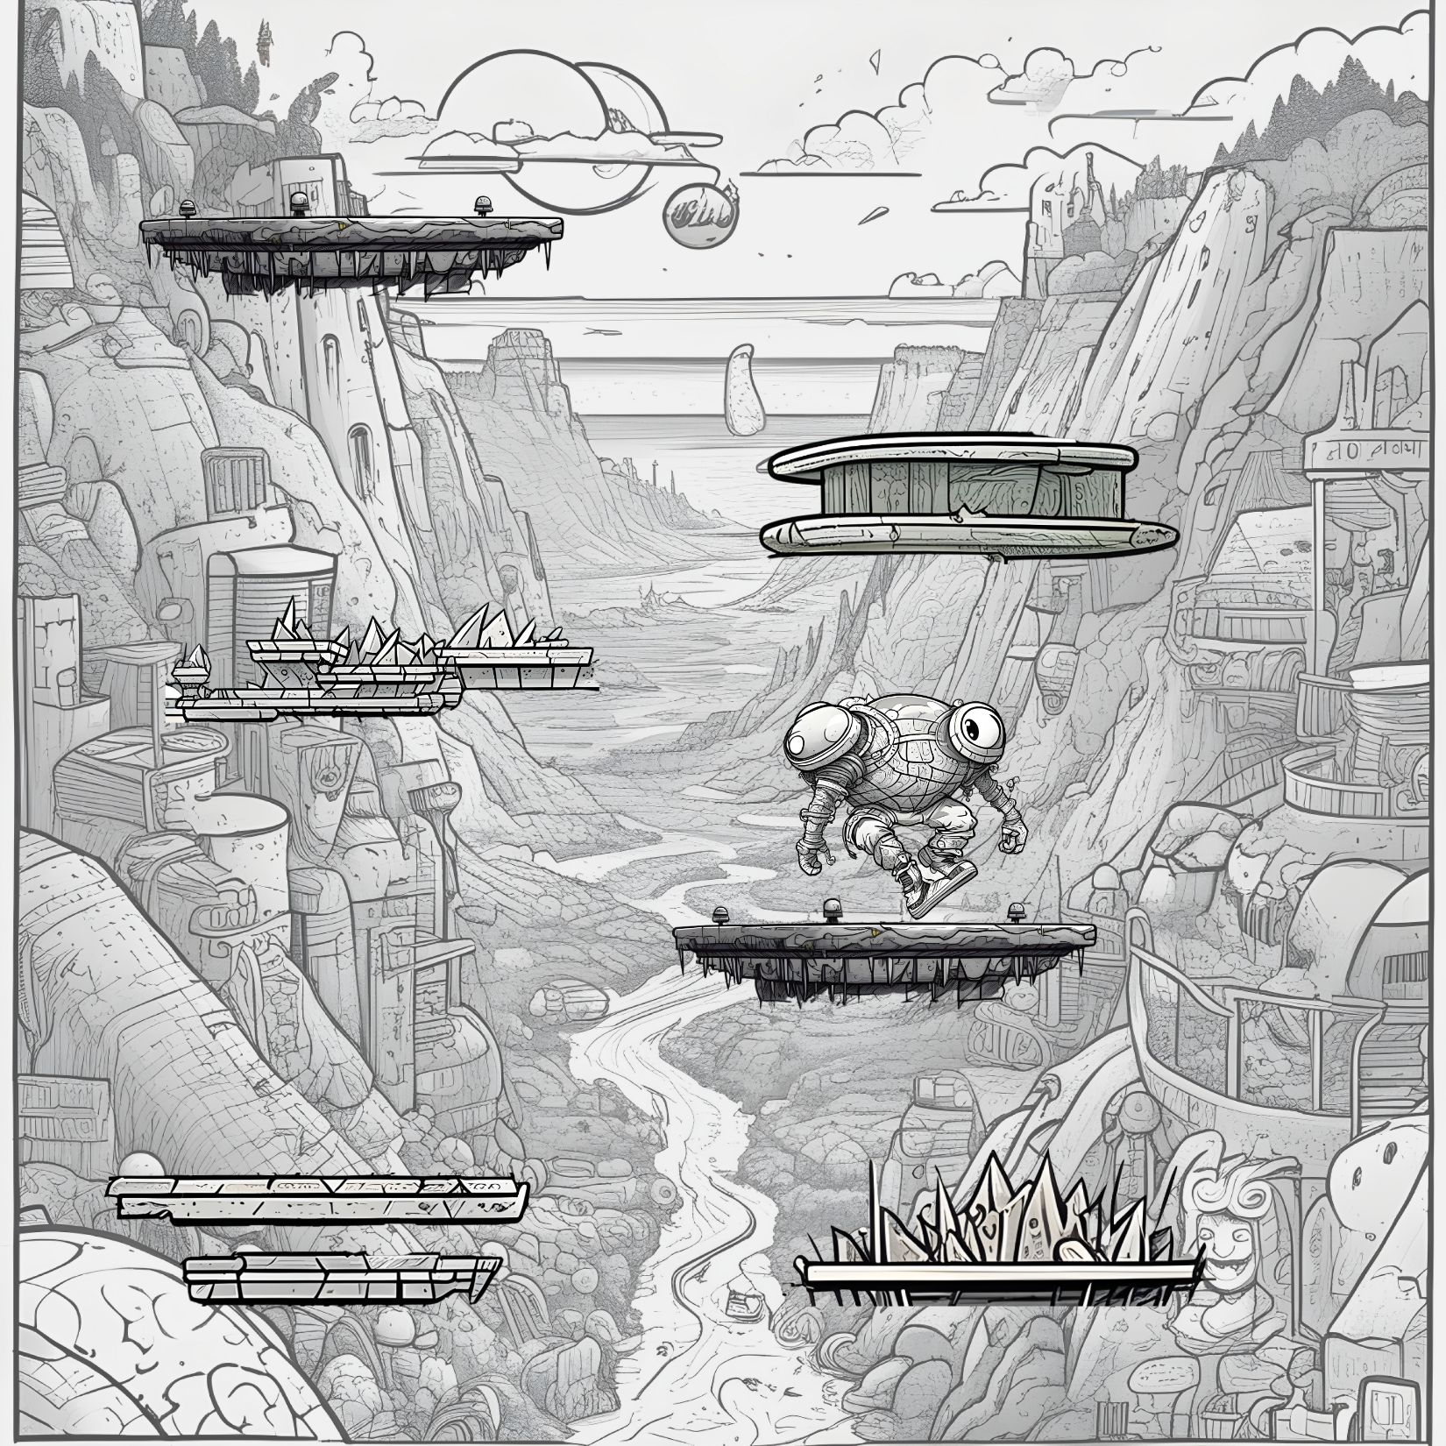
Our game: Space jump
Embark on an interstellar adventure with Space Jump, a mobile game inspired by Doodle Jump.
Make your steller ascend through cosmic platforms, navigating a challenging maze of space obstacles.
Propel your steller to cosmic heights and achieve an out-of-this-world high score.
Space Jump

Slide 5
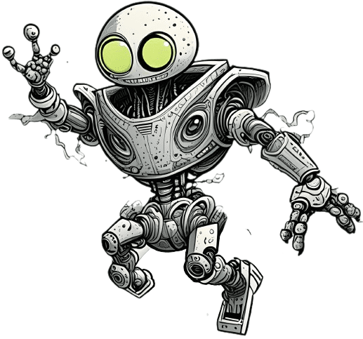
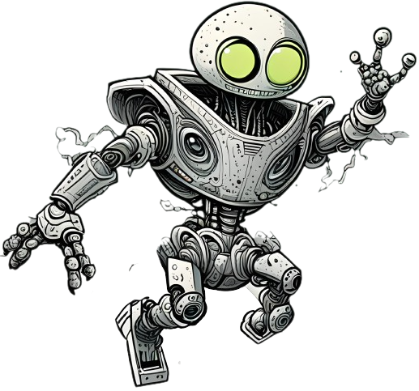
Controls:
Click “ “ to make your steller to move towards left
Click “ “ to make your steller to move towards right

Slide 6
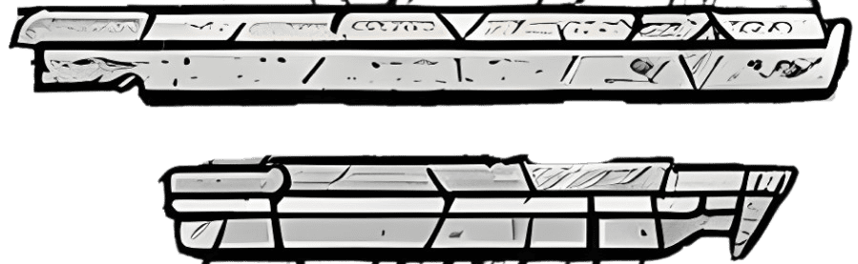
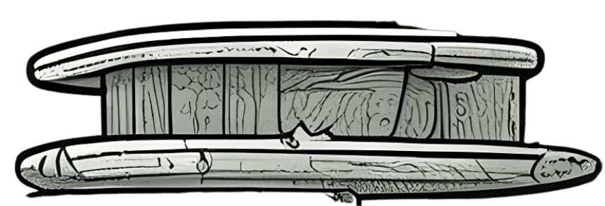
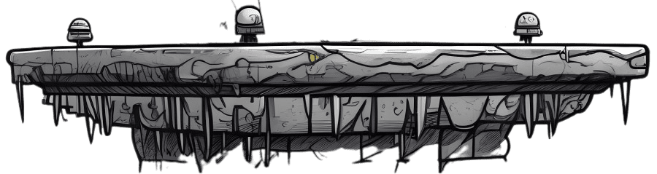
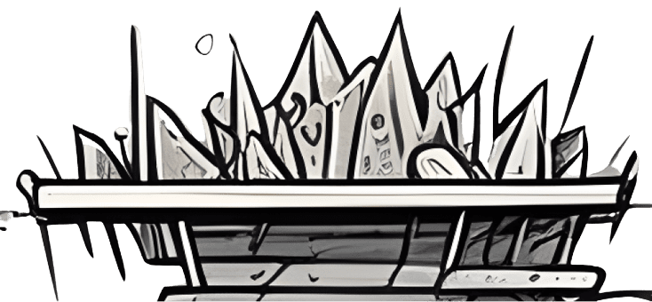
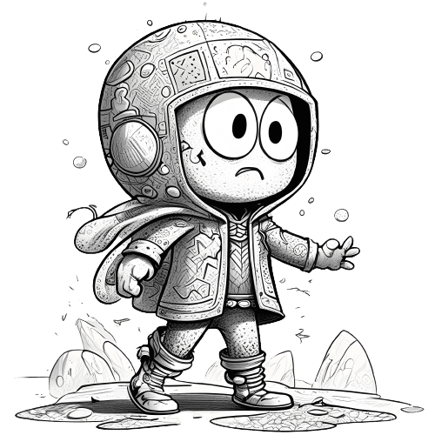
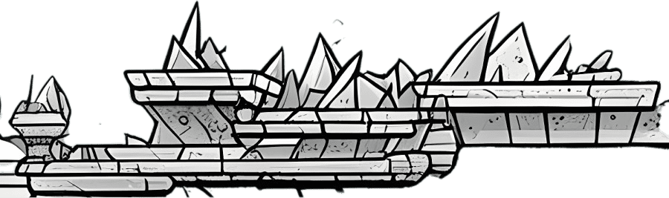
Rules and Scores:
1. Make your steller Jump on these, get scores
2. Avoid These, else die
3. If your steller falls off the screen, it dies

Slide 7

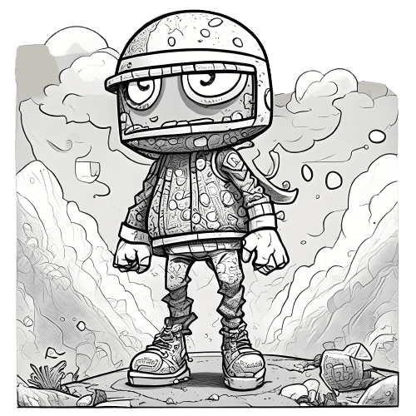
ITS THAT SIMPLE!!!!!

